Slide 1
Improving Automated Search for Underwater Threats Using Multistatic Sensor Fields by Incorporating Unconfirmed Track Information
Steve Mehrkanoonª, Daniel Angleyª, Christopher Gilliam^{b}, Bill Moranª, Sergey Simakov^{c}
ªFaculty of Engineering and Information Technology, The University of Melbourne, Parkville, VIC 3010
^{b}School of Engineering, RMIT University, Melbourne, VIC 3000
^{c}Defence Science Technology Group, Maritime Division, Edinburgh SA 5111
IEEE International Conference on Autonomous Systems – Montréal, Canada – August 11-13 2021

Slide 2
Objective
Optimise the scheduling of waveform transmissions (pings) from sonobuoys in order to search for an underwater target in an Operational Area (OA)
Sonobuoy field is a network of sonar transmitters and receivers
Scheduling is deciding which sonobuoy should ping in a given ping interval
Success is either clearance of the OA or the detection and accurate tracking of a target
Target confirmation is challenging:
Each ping can result in multiple detections that may or may not relate to a target
Tracker only confirms a target when there is a high probability that a track is associated with a target
Optimisation goals:
Decrease the number of pings required to confirm target presence and find approximate location
Reduce the probability of false confirmation
images.defence.gov.au

Slide 3
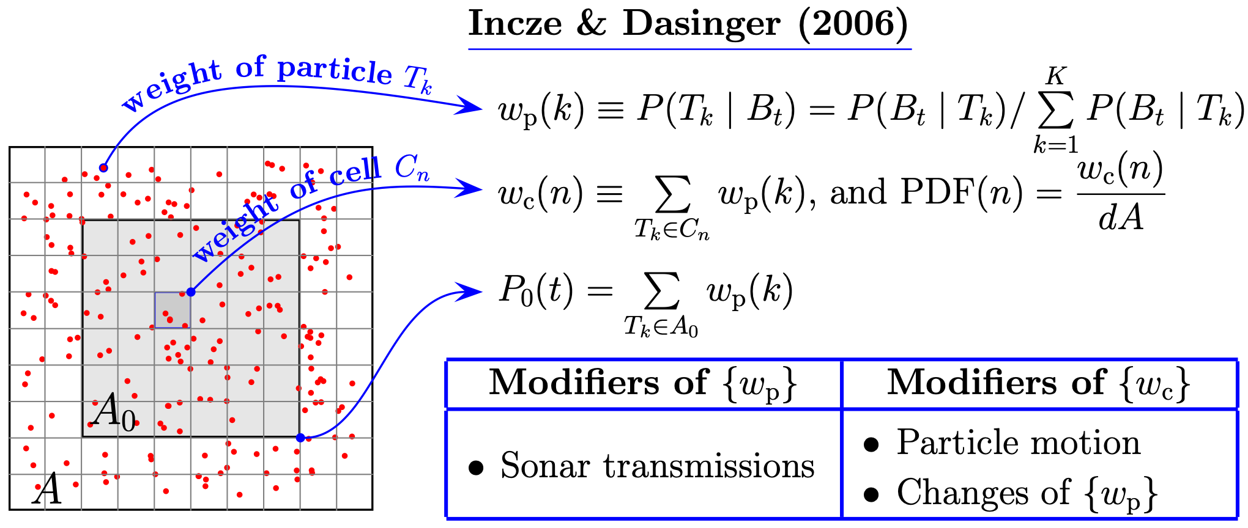
Threat Map
A threat map represents the spatial PDF of an existing but undetected target
Used to make intelligent ping scheduling decisions
We use the Incze & Dasigner method [1], a Monte Carlo approach using a large number of virtual targets, with GPU acceleration [2]
[1] B. I. Incze and S. B. Dasinger. A Bayesian method for managing uncertainties relating to distributed multistatic sensor search. In Proceedings of the 9th International Conference on Information Fusion, pages 1–7. IEEE, 2006.
[2] S. Simakov and F. Fletcher. GPU acceleration of threat map computation and application to selection of sonar field controls. In IEEE International Conference on Acoustics, Speech and Signal Processing (ICASSP), pages 1827–1831. IEEE, 2015.

Slide 4
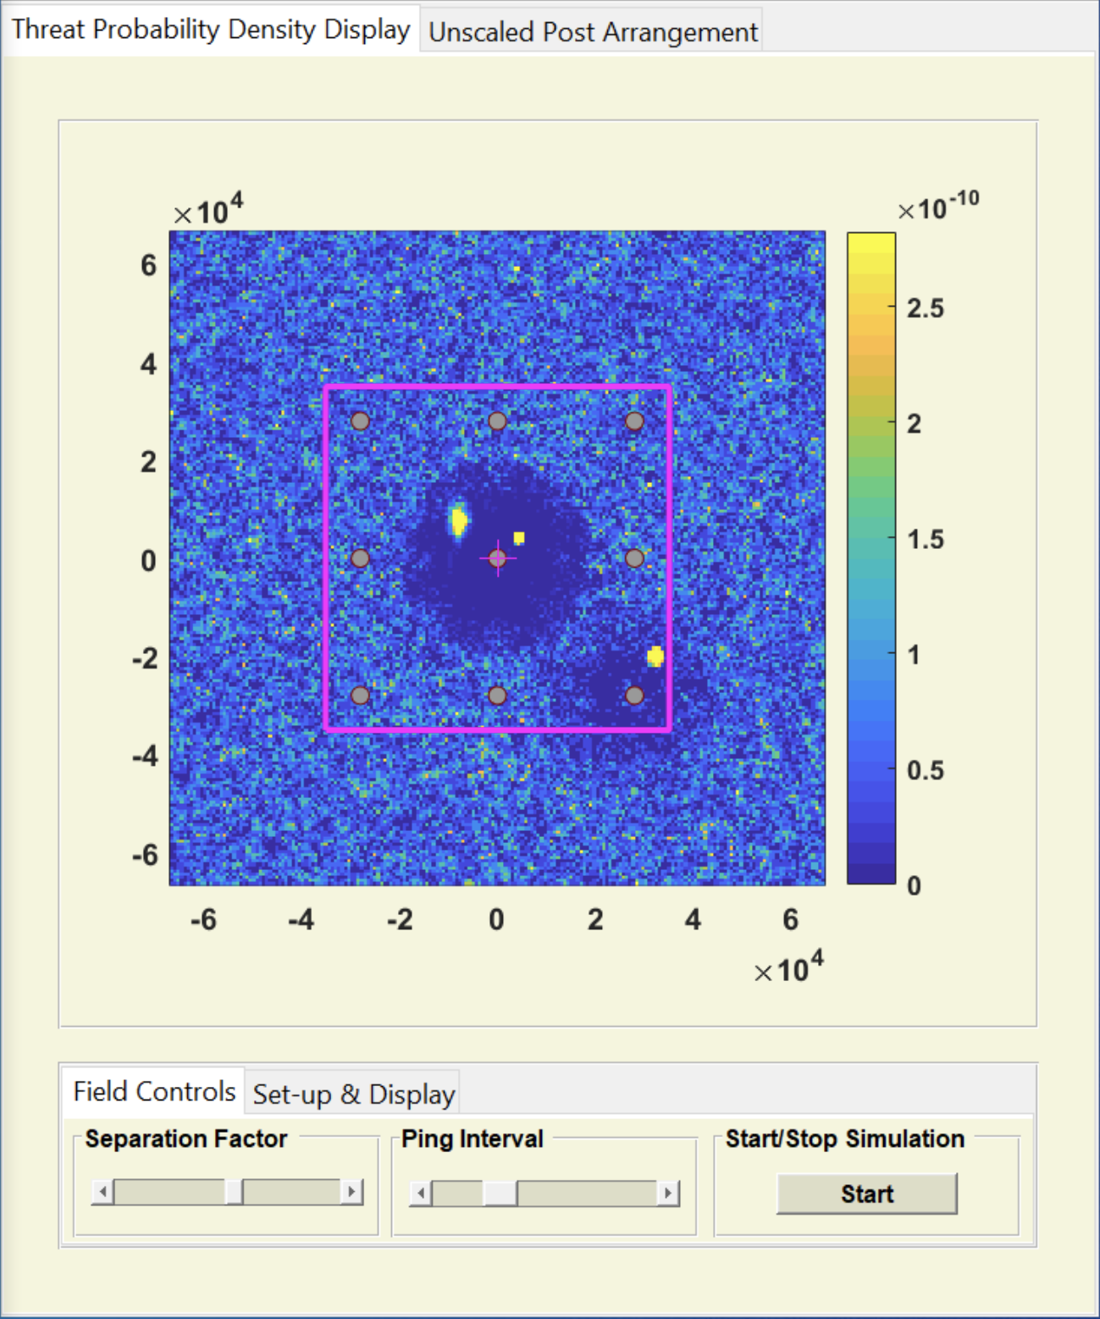
Incorporating Unconfirmed Tracks
Existing threat map models are offline methods, i.e. they do not take into account detection information available during operation
If you get one or more detections in an area you may want to schedule future pings around there in order to confirm or deny the presence of a target
The tracker models these detections as unconfirmed tracks, with an estimate of the location $x_{k}$, covariance matrix $C_{xy}^{k}$ and probability of existence $p_{e}$ (i.e. probability that the track is associated with a true target) for each unconfirmed track ($k=1,…,K_{t}$)
Form a 2D Gaussian correction to the evolving threat map PDF $p(x,t)$:
$$p(x,t)↦γ_{0}p(x,t)+\overset{K_{t}}{\underset{k=1}{∑}}γ_{k}G(x−x_{k};C_{xy}^{k})$$
where $G(x;C_{xy})≡\frac{exp\left(−\frac{1}{2}x^{T}C_{xy}^{−1}x\right)}{2π\sqrt{detC_{xy}}}$ and $\overset{K_{t}}{\underset{k=0}{∑}}γ_{k}=1$
Unconfirmed Tracks

Slide 5
Simulation Environment
Threat Map
Threat Probability Density Map (TPDM) GPU code by DSTG/Sergey Simakov [1]
Measurement Simulation
Bistatic Range Independent Signal Excess (BRISE) simulation environment by DSTG/Sergey Simakov [2]
Uses signal excess lookup tables precomputed using the Gaussian ray bundle eigenray propagation model
Linear frequency modulation (LFM) waveform centred at 2 kHz with a transmission duration of 2 seconds and bandwidth of 200 Hz
Tracker
Gaussian mixture implementation of the multi-sensor Bernoulli filter (optimal Bayesian multi-sensor filter for a single target) extended to multiple targets using the linear-multitarget paradigm [3]
images.defence.gov.au
[1] S. Simakov and F. Fletcher. GPU acceleration of threat map computation and application to selection of sonar field controls. In IEEE International Conference on Acoustics, Speech and Signal Processing (ICASSP), pages 1827–1831. IEEE, 2015.
[2] S. Simakov. Signal excess data and tools for multistatic sonar emulation. Tech. Report DSTO-TR-3026, DSTO, 2014.
[3] B. Ristic, D. Angley, S. Suvorova, B. Moran, F. Fletcher, H. Gaetjens, and S. Simakov. Gaussian mixture multitarget–multisensor Bernoulli tracker for multistatic sonobuoy fields. IET Radar, Sonar & Navigation, 11(12):1790–1797, 2017.

Slide 6
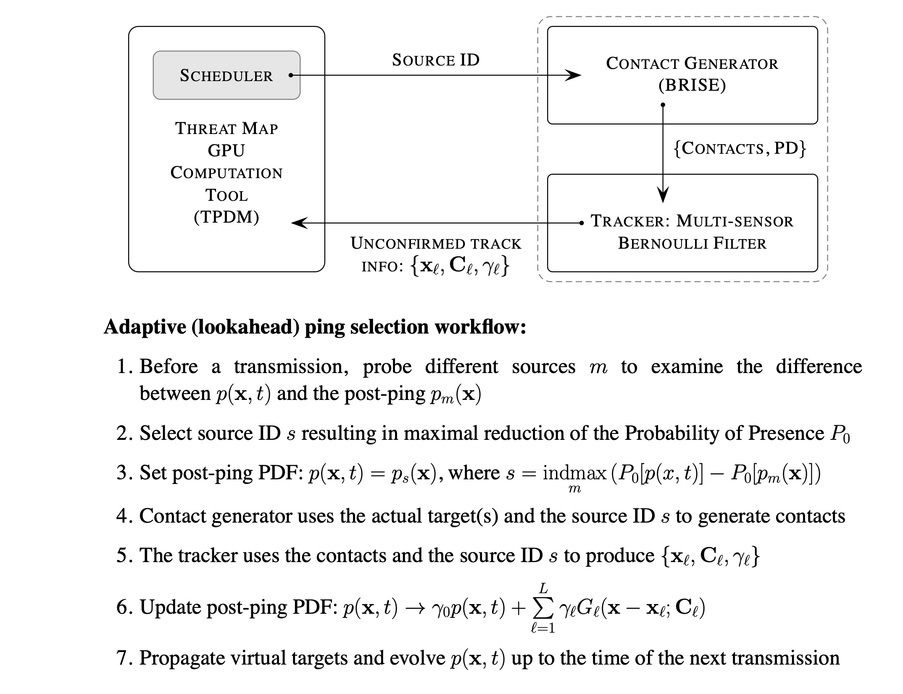
Scheduling Algorithms
Compare 4 different scheduling algorithms:
Raster - Predefined looping raster pattern
Random - Ping from a uniformly random sonobuoy
Lookahead - Use threat map to select the sonobuoy to ping from that minimises the probability of target presence in the OA
Unconfirmed - Lookahead method with unconfirmed tracks incorporated into threat map

Slide 7
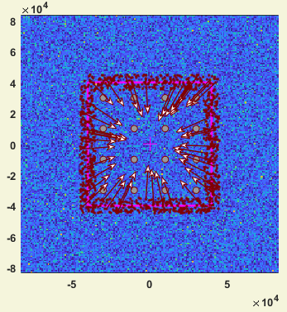
Scenario
16 sonobuoys (grey circles) in grid spaced 20 km apart, co-located transmitter and receiver
OA is an 80x80 km region (pink square) around sonobuoys
Targets (red dots) start at a uniformly random position in a 5 km neighbourhood of the OA boundary and move towards centre (arrows)
Performance metrics:
Number of pings until a track is confirmed
Proportion of falsely confirmed tracks (> 1 km from true target)
Distance between target and confirmed track (excluding false confirmations)
1,000 Monte Carlo simulations

Slide 8
Scheduling Algorithms
Raster
Random
Lookahead
Unconfirmed

Slide 9
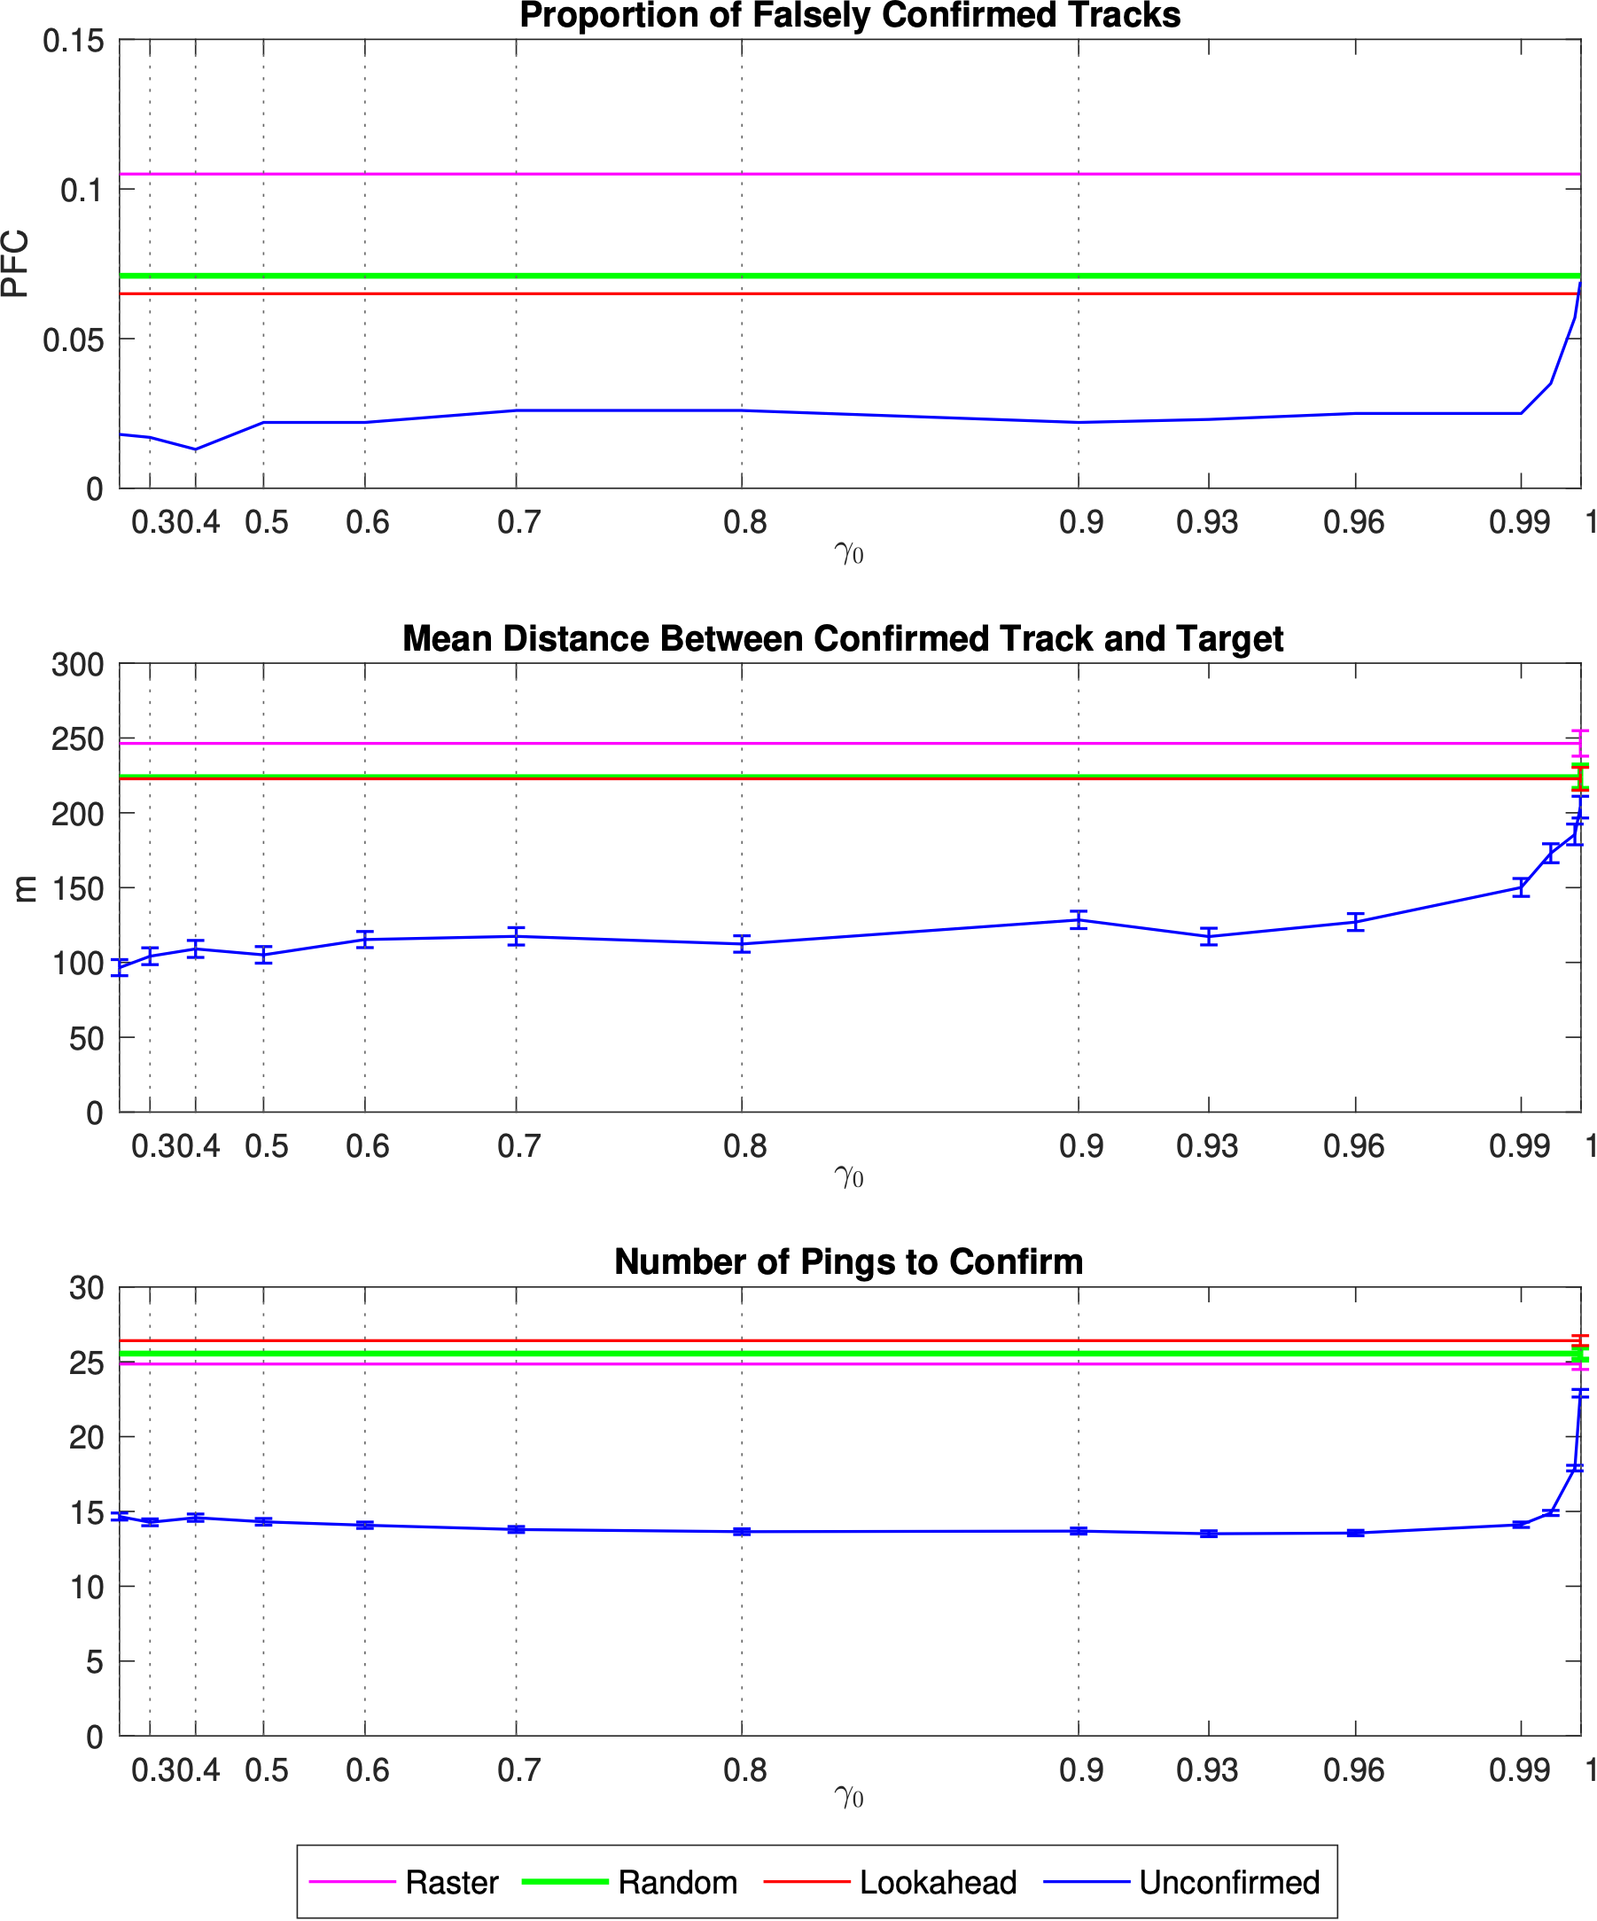
Results
Unconfirmed method is fairly insensitive to value of $γ_{0}$
Unconfirmed track information reduces the number of pings to confirm a target
24.9 pings (Raster) to 13.5 pings (Unconfirmed with $γ_{0}$ = 0.93)
Decreases the proportion of falsely confirmed tracks and the track error
Not just confirming false tracks faster

Slide 10
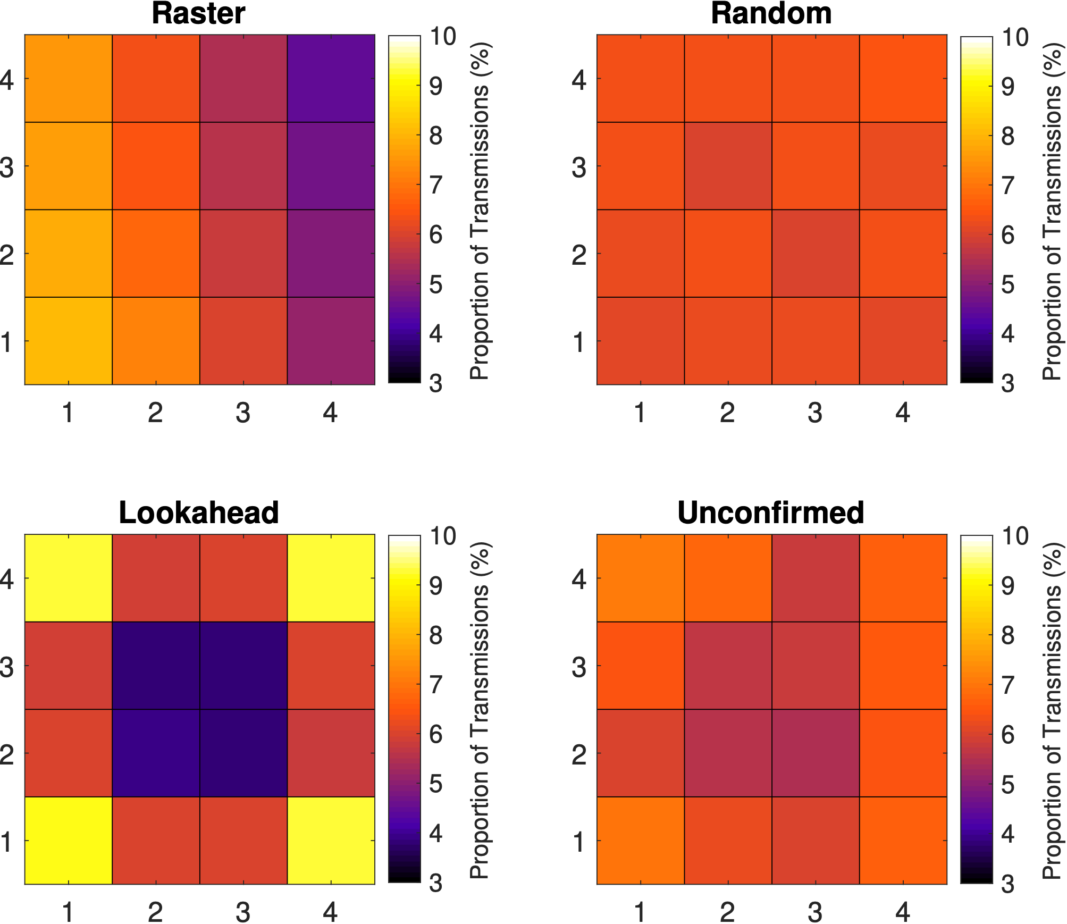
Sonobuoy Usage
Characteristic scanning pattern
Uniform usage
Also focused on the corners & edges, but investigating unconfirmed tracks inside
Focused on the corners & edges

Slide 11
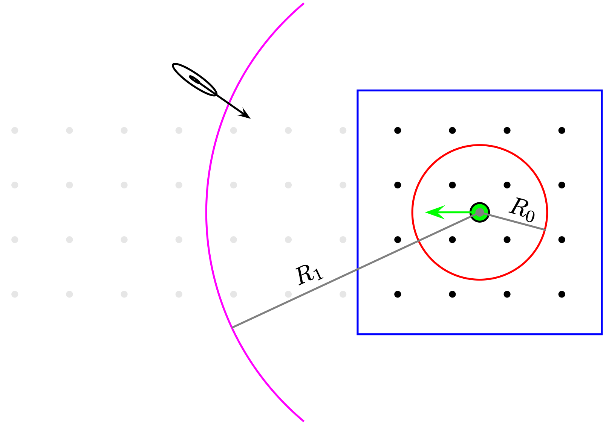
Possible Future Work
Tracker parameter tuning
Unconfirmed track initiation is a balance between discarding useful detections and creating many unconfirmed tracks
Moving OA
Defend a valuable asset en route by maintaining clearance of a moving OA
New sonobuoys are placed ahead of the moving OA to search for targets
Old sonobuoys drop out of field (e.g. out of communication range)
Target
Moving OA
images.defence.gov.au

Slide 12
Questions

Slide 13
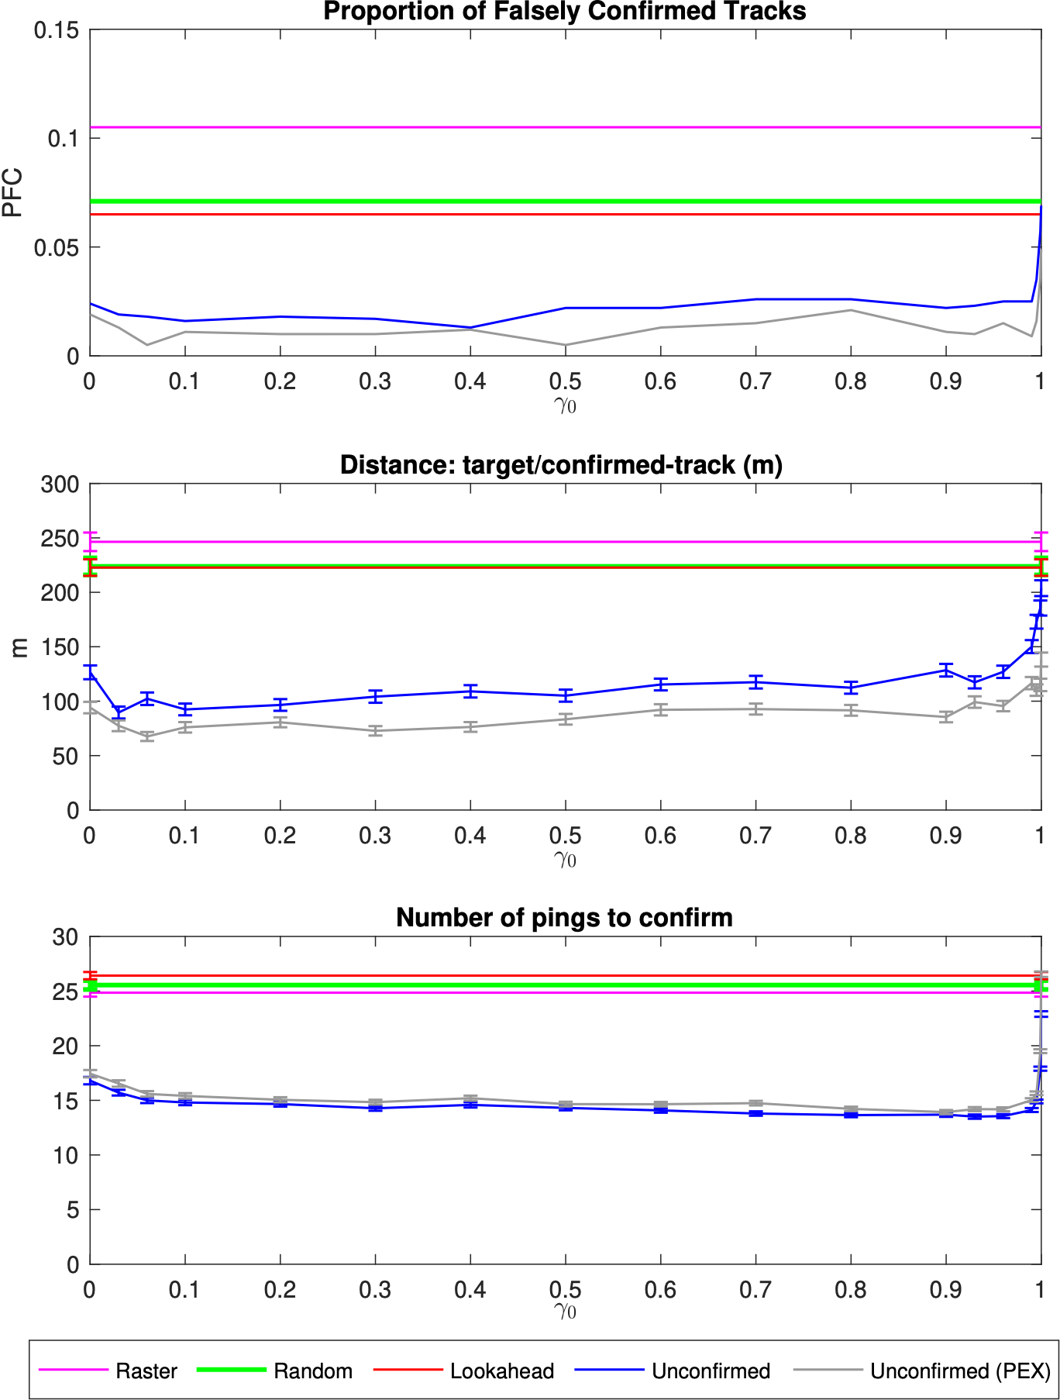
Probability of Existence Weighting
Tracker produces a probability of existence estimating the probability that a track is associated with a true target and not the result of false detections
Should this be used to weight the Gaussian corrections to the threat map?
$$γ_{k}=(1−γ_{0})\frac{p_{e(k)}}{\sum_{i=1}^{K_{t}}{p_{e(i)}}}$$
Results
Slightly increases the number of pings to confirm, but decreases false confirmations and track error
$p_{e}$ is bimodal, with most tracks having low $p_{e}$

